Slide 1

WELCOME

Slide 2
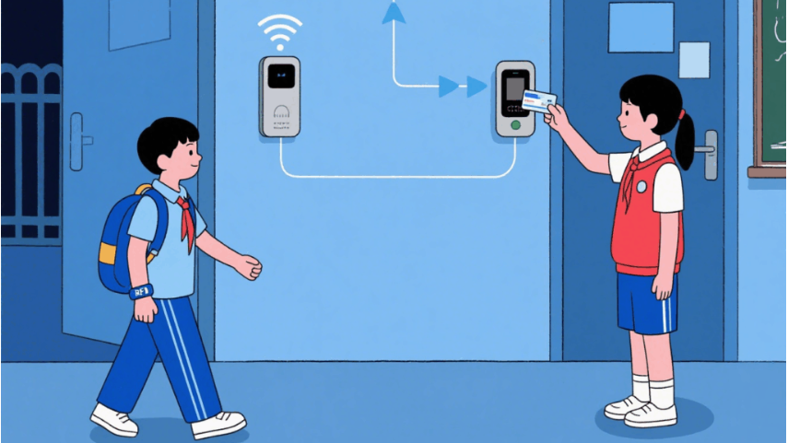
RFID Attendance System

Slide 3
Zainab Sultan
23-NTU-CS-1097
Rida khan
23-NTU-CS-1087
Qurat ul Ain
23-NTU-CS-1085
Project members

Slide 4
Zainab Sultan
23-NTU-CS-1097
Rida Khan
23-NTU-CS-1087
Qura-tul-Ain
23-NTU-CS-1085

Slide 5
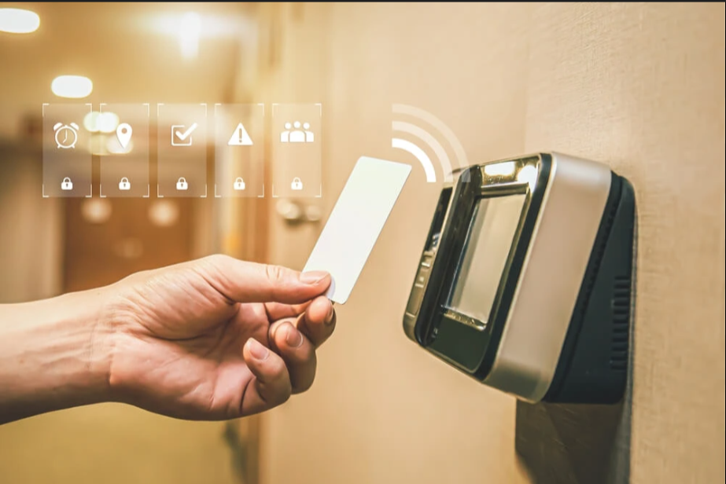
Introduction
• RFID Attendance System automates student attendance • Replaces manual paper-based attendance • Uses RFID cards and ESP32 microcontroller • Attendance stored securely on cloud

Slide 6
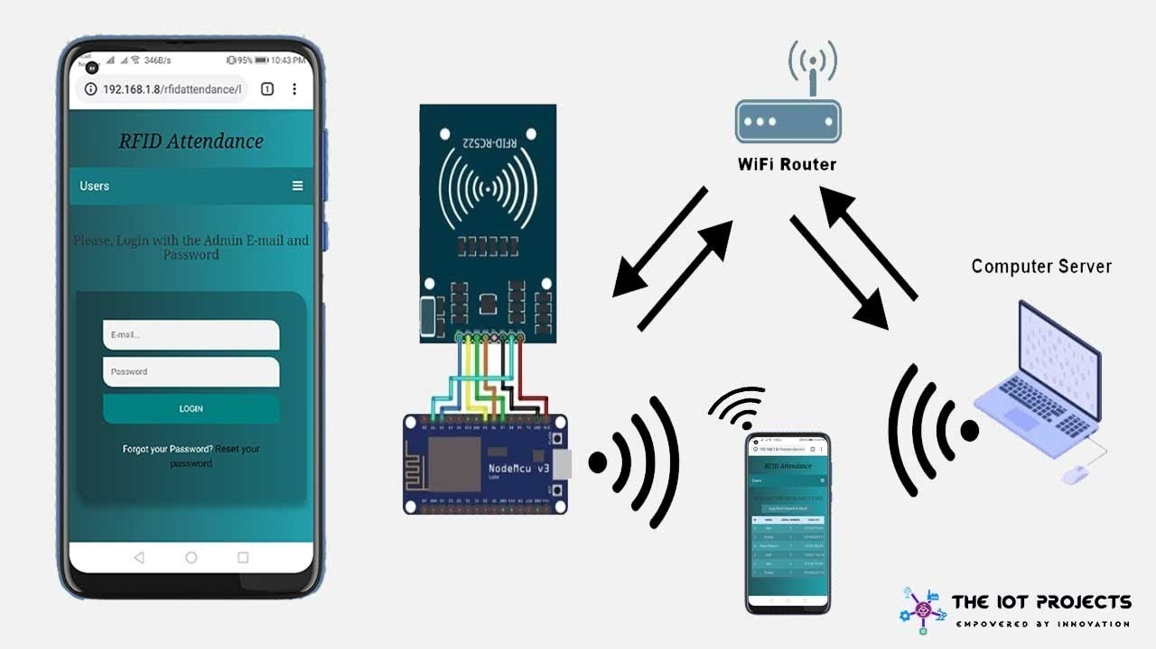
Background
• Traditional attendance is time-consuming • Manual records are error-prone • Proxy attendance is common • No real-time access to records

Slide 7

Purpose of the Project
• Automate attendance process • Use RFID cards for identification • Record attendance in real time • Upload attendance to Google Sheets (cloud)

Slide 8

Scope of the System
• RFID card scanning • Student identity verification • Duplicate attendance prevention • Online attendance storage

Slide 9

Objectives
• Eliminate manual work • Improve accuracy of attendance • Enable cloud-based access • Save time for teachers

Slide 10
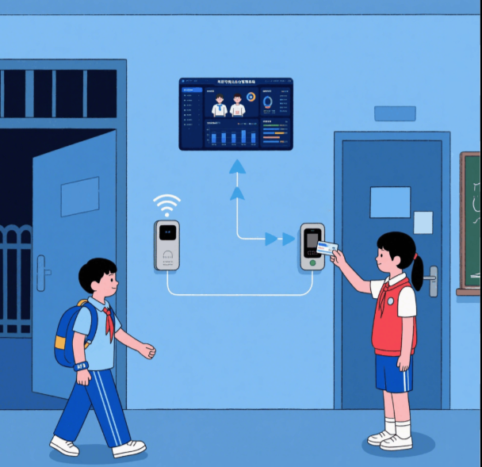
Target Audience
• Students – automatic attendance marking
• Teachers – easy monitoring and management
• Educational institutions – cloud record keeping

Slide 11
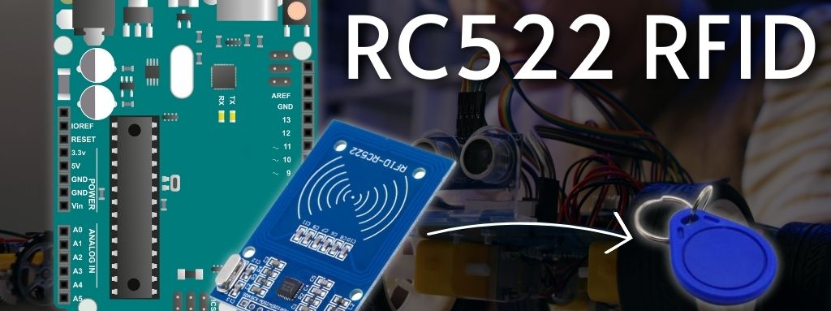
System Features
• RFID-based student identification • Automatic attendance marking • Duplicate scan prevention • Audio & visual confirmation • Cloud-based attendance storage
This Photo by Unknown Author is licensed under CC BY-NC

Slide 12
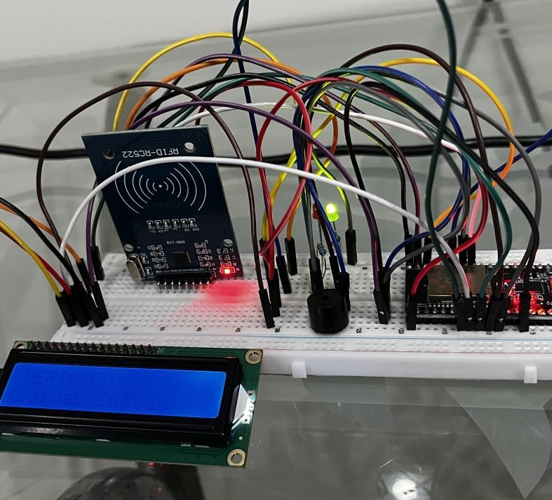
Hardware & Software Used
Hardware:
ESP32
RFID RC522
RFID Cards
OLED Display
LEDs & Buzzer
Software:
VS Code + PlatformIO
Google Apps Script
Google Sheets

Slide 13
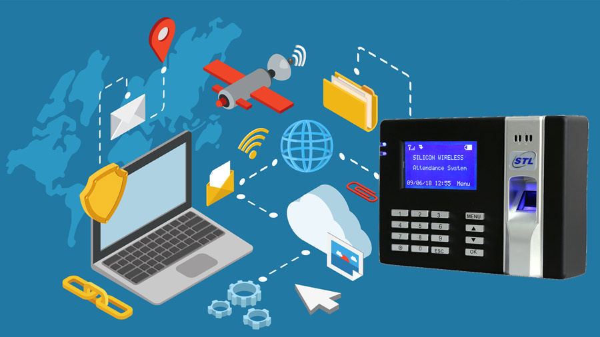
Testing & Results
System connects to Wi-Fi successfully
Duplicate card → Red LED + double beep
Fast, accurate, and reliable system
Valid card → Green LED + short beep
Attendance updated in Google Sheet

Slide 14
Working of the System

Slide 15
Working of the System
3. ESP32 verifies student
4. Attendance recorded with date & time
5. Data sent to Google Sheets
2. RFID Reader reads UID
1. RFID Card is scanned
6. Card scanned again

Slide 16
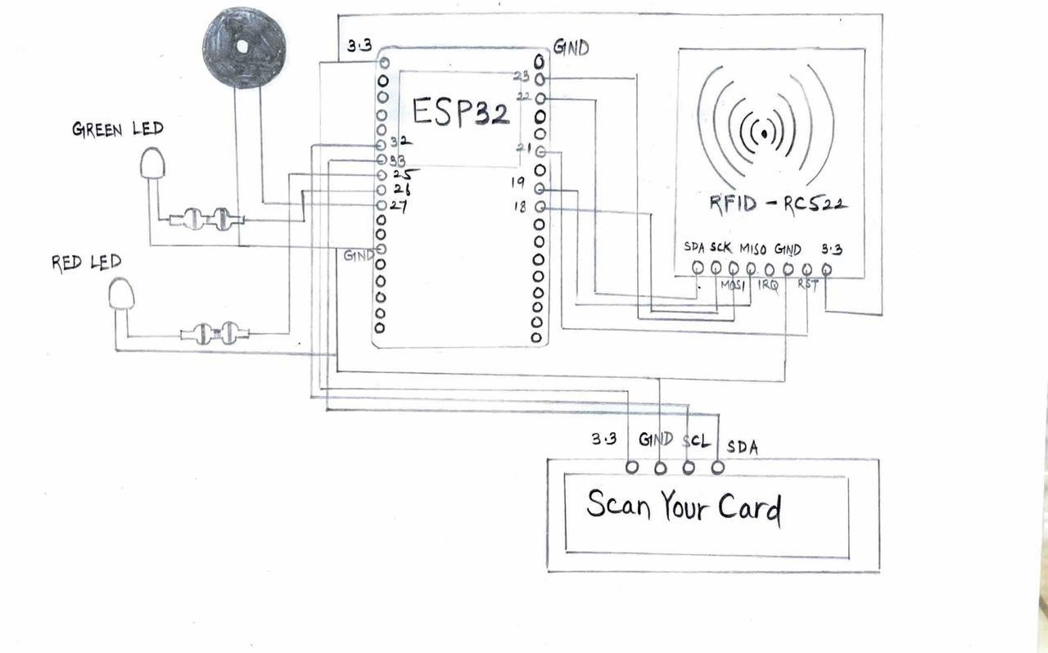
Conclusion & Future Scope
Automates attendance efficiently
Eliminates proxy and manual error
Cloud-based record access
Future Enhancements:
Mobile app integration
Multiple classes & sections

Slide 17


Thank you

